Slide 1



Ultimate Destination for Home Utility Services
HomeEase Solutions
Vishal Waje:- 230360820060
Dipali Waghmare:- 230360820012

Slide 2
Agenda
Introduction
Choice of topic
Proposed System
Methodology
System Model
Approach
Screenshot
System Requirement
Application
Advantage And Limitation
Conclusion
Future Scope
Reference

Slide 3
Introduction
Giving a thought to that aspect of life is to design and develop a system that provides many services at your doorstep in just one click.
A System that provides variety of services like electricians, painters, plumbers, movers and packers, repair persons, cleaners, electricians, painters and many more.
To make it comfortable for all the users our system also provides a mobile environment which offers ease in accessing our services.
System is versatile as service can be booked from everywhere to anywhere you desire.

Slide 4
Choice of Topic
In present scenario, people are buried up in a heavy work culture, as everyone is engaged with busy schedules, and hectic tasks which make them deviate from family life.
If any issues encounter unexpectedly, it distracts them and makes them choose over the work they have to accomplish primarily. It is important to manage both professional and family life.
In such situation’s E-Commerce plays a vital role in today’s life as it has so many advantages in our life because it makes convenient in daily life of the people.
We at HomeEase aim to help in providing optimal solutions to all your household troubles with more efficiency, ease and majorly, a delicate touch.

Slide 5
Proposed System (B2C)
HomeEase is a platform to make our urban lives more fulfilling to solve our needs in a Ease. Hence the name, HomeEase.
Better Communication with Customers: Prime advantages for this business is the increased efficiency of communication channels. Customers can directly resolve their queries and issues.
Order Tracking: Customers can track their orders and modify the orders at any point of time.
Service Suppliers: HomeEase focuses on hiring professionals for the service in each type. Thus leading to customer satisfaction and a voice of VOCAL FOR LOCAL.

Slide 6
Other Benefits:
Commission less approach.
Eliminates Intermediate(B2C).
Lead generation.
Advertisements- Service providers, businesses, and manufacturers run their advertisements through the HomeEase platform.

Slide 7
Methodology
MICROSERVICES ARCHITECTURE
The most in demand architecture in IT industry for developing WEB based application.
JWT-TOKEN SECURITY
To provide an authenticated and authorized login module for the users such as service seekers, service providers and the admin, by providing appropriate credentials at the time of registration.

Slide 8
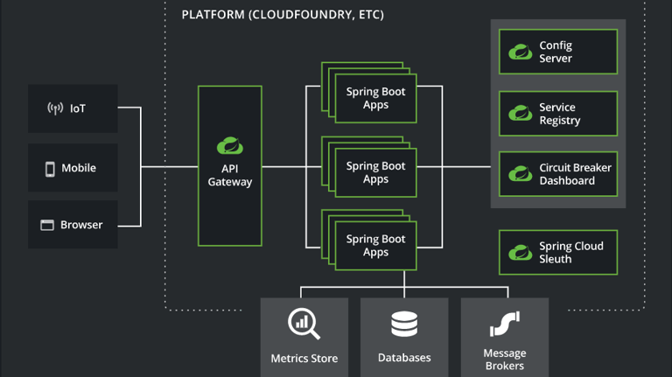
MICROSERVICES ARCHITECTURE

Slide 9
Methodology
REACTJS FRONTEND
To develop a web based online system for opting household services and design a interactive User Interface for seeking services on the go.
JAVA BASED SPRING BACKEND
To provide data security and Object oriented programming which is lightweight, loose coupling, cross cutting behavior, declarative, powerful abstraction, fast and productive.

Slide 10
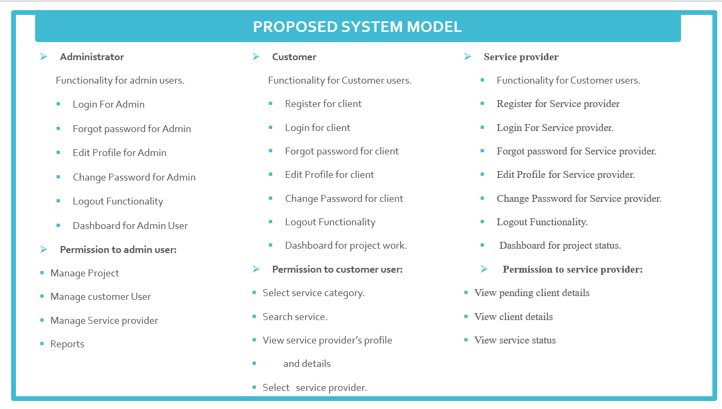

Slide 11
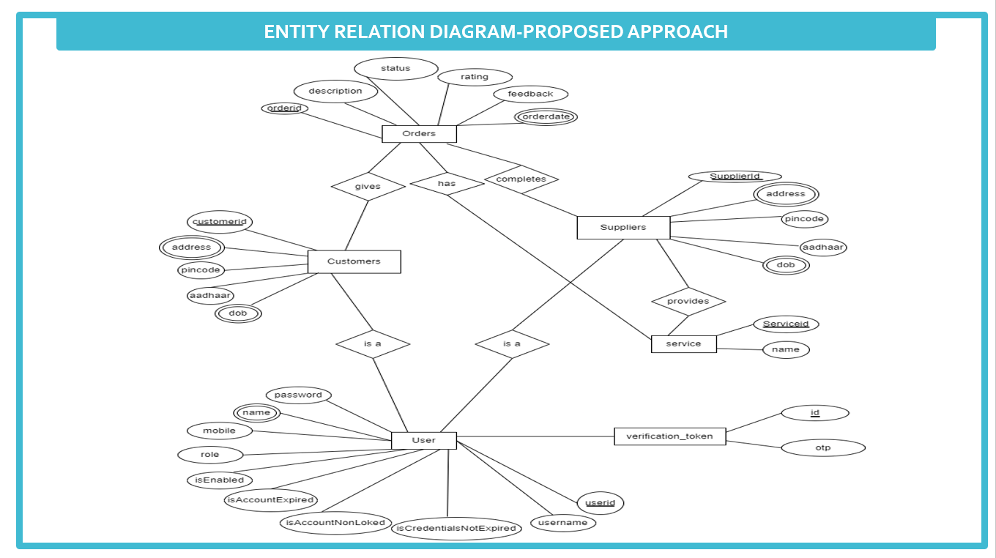

Slide 12
Screenshots

Slide 13
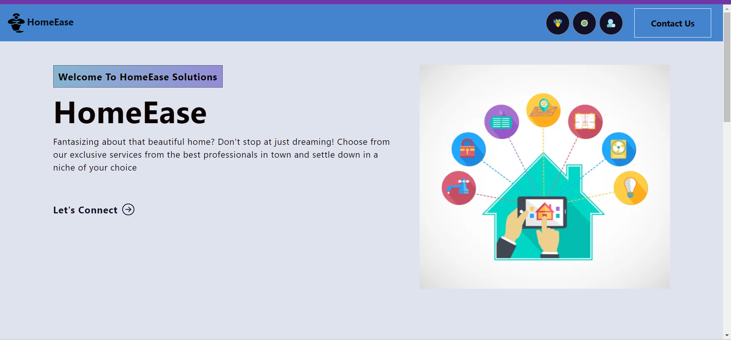
Homepage

Slide 14
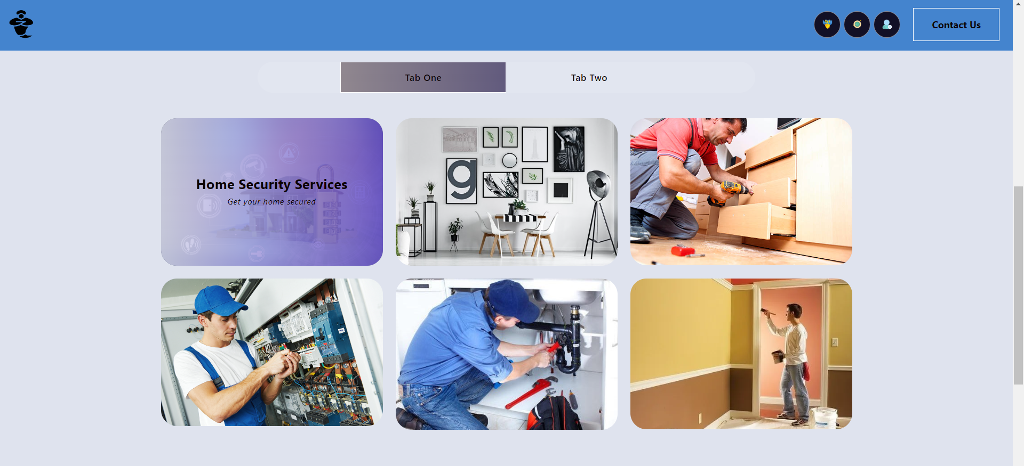
Services Tab

Slide 15
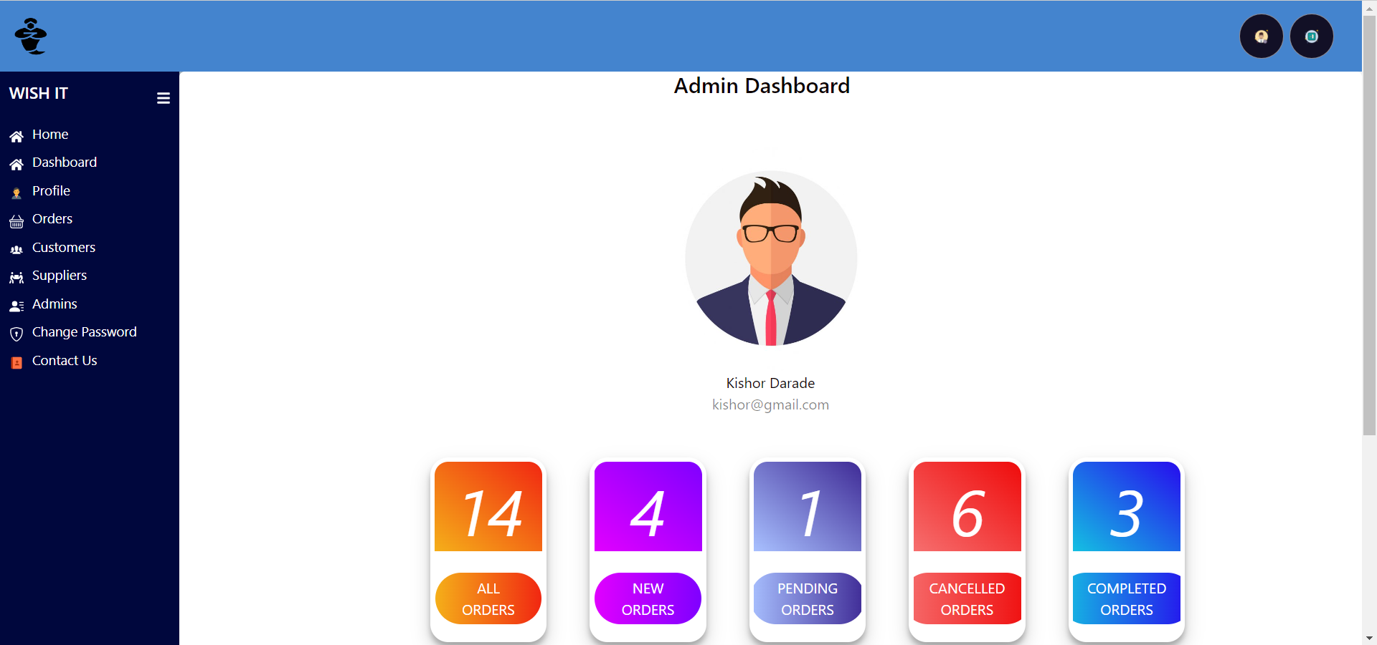
Admin Dashboard

Slide 16
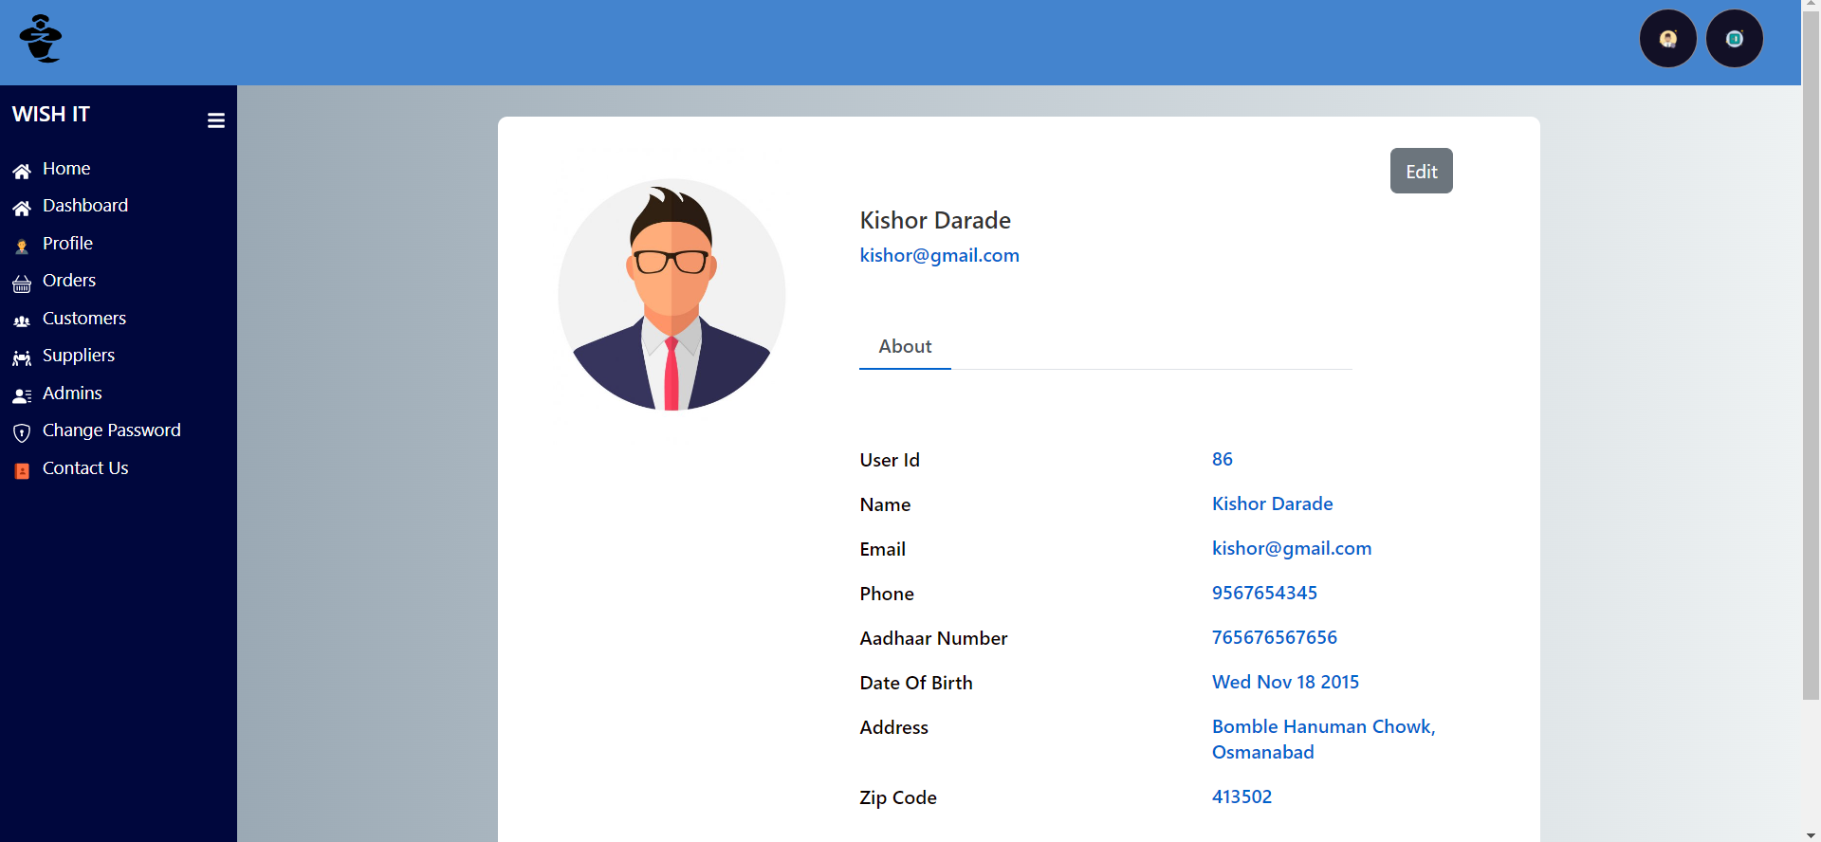
Profile Page

Slide 17
System Requirements
Software Requirements:
Windows 7 & above.
VS Code 1.x and above for REACT, JS, NODE express, Bootstrap, HTML, CSS.
Eclipse Oxygen and above stable version (J2SE).
Spring Tool Suite 4.x or any stable version.
Postman
MySQL 8.x or any stable version.
Git Hub
Hardware Components:
Processor – i3 and above.
Hard Disk – up to 3GB.
Memory – up to 1GB RAM

Slide 18
Technologies
React JS
Web Java
Junit 5
MySQL
GitHub

Slide 19




Applications
DIGITAL MARKETING OF LOCAL BUSINESSES
DAILY ROUTINE PROFESSIONALS
HOME SERVICES
MAINTENANCE AND REPAIRS

Slide 20
Advantages
The home service app provides convenience.
Customer Relationship Management.
It has a lower cost.
Save Time.
Don’t have to do extensive background checks, as the app does it for you.
Eliminates Intermediate fares.

Slide 21
Limitations
Limited Sampling and Respondent Availability
Certain populations are less likely to have internet access and to respond to online questionnaires.
No Physical Interviewer
The lack of a trained interviewer to clarify and probe can lead to less reliable data.
Possible Cooperation Problems

Slide 22
Future Scope
The online household services application provides some of the home services which are most frequently used.
This system accommodates the changing needs of the end user.
The overall system can be designed so that its capacity can be increased in response to the further requirements for which the application provides an appropriate service overseas.
Further this application can be prolonged by merely adding up the required services and additional payment systems. For example, the current system provides the following services such as home painting, home cleaning, packers and movers, plumber repair and service further the system can be extended as per the requirements of the user.
The system can have prolonged by adding the services such as mobile and various electronic repair, laundry services, catering services and many more.

Slide 23

CONCLUSION
To reduce burden in finding in-house solutions for the services, the proposed system provides several services by providing service specialists at your doorstep in one click.
A systematic mobile environment to system clients offers ease in accessing our services in a more comfortable way.
With well qualified and background demonstrated professionals we make all your home cleaning, plumbing, furniture maintenance, electrical works, appliance repair, house painting, vehicle service and many other services to be done in a click anytime from anywhere as easy as available.

Slide 24
References
Mr. Sakthi Saravanakumar Sir to co-ordinate and support during project.
Mrs. Sumithra Ma'am, for guiding us throughout the Course.
International Journal of Engineering Research & Technology (IJERT) An Online System for Household Services. Special Issue – 2018.
Website & YouTube Channels: Durga Software Solutions, Stackoverflow, Geeksforgeeks, Javatpoint, W3schools, Daily code buffer, Java Techie, Edureka, Gatesmashers, Java brains, Learn code with Durgesh, Naresh i technologies, Neso Academy, Sanjeev Thiyagarajan, Smart programming, TechEFX, WsCube Tech, Krish Dinesh.
Special thanks to ACTS Chennai Pvt Ltd. for providing us the knowledge and giving us capability to deal with new technologies during the project.

Slide 25
Thank You
Dipali Waghmare:- 230360820012
Vishal Waje:- 230360820060

